Slide 1


ECNU
Design and Implementation of APP for Personalized English Vocabulary Learning
Author: Wang LiLin
Instructor: Jiang NingKang

Slide 2
Background
Mobile learning has overcome the limitations of traditional teaching environment since it’s not limited by time, space and learning content. Learners can use mobile learning to autonomously find the learning resources they need to make up for the shortcomings and defects of in-class teaching.
According to the current research situation, the enthusiasm of learners can be improved from psychological factors, thereby reducing students' negative attitudes towards mobile learning, and improving the usability and acceptability of mobile learning.

Slide 3
Target
This research aims to analyze the word learning mode of existing mobile learning applications, integrate the original application functions, and improve the management module so that the statistical results can be directly applied to the application module.
This system hopes to improve the scope of personalized learning by improving the expected effect, expected workload and convenient function factors, so that learners can be more efficient and targeted in self-learning.

Slide 4
Content
Part Ⅰ
Part Ⅱ
Part Ⅲ
Part Ⅳ
Part Ⅴ
Analysis
Design
Implement
Test
Results & Discussion

Slide 5

Analysis
Explains the system requirements obtained after the preliminary research, and conducts requirements analysis on them. The function points are refined in the form of UML, and finally all the function modules are connected in series to complete the process design.

Slide 6

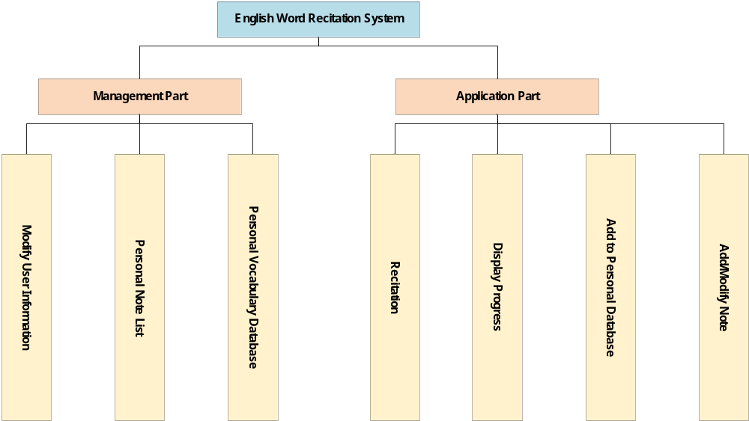
Analysis（Functional Analysis）
Requirements Analysis
Firstly, divide the functional requirements of the system.
Management Part
Used to record user information and feed it back to the application part
Application Part
Responsible for task giving and learning resource management
Figure1 System Function Analysis

Slide 7
Analysis（Functional Analysis）
Use Case Description
Use Case | 名前
No | 番号
Actor | 参加者
Brief Description | 概要
Pre-Condition | 事前条件
Post-Condition | 後置条件
Main Success Scenario | 基本的な流れ
Extensions | 他の流れ
Details
In the use case description, structured detailed use cases are used to explain the main use cases. Details in the requirements are showed, and use case diagrams are used to make the description and communication clearer.

Slide 8
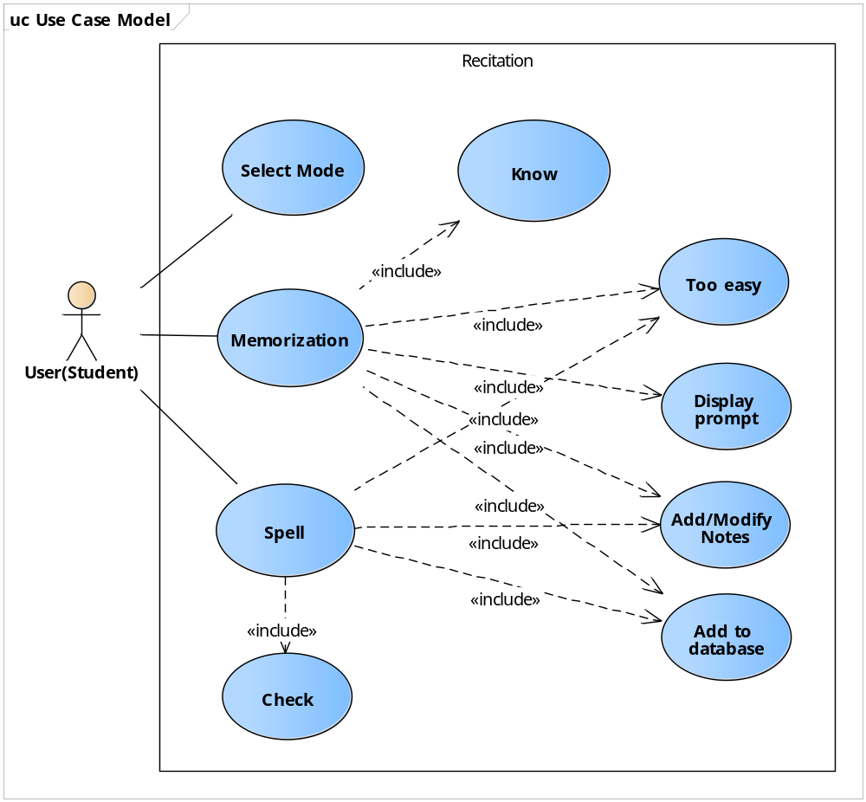
Use Case | Recite under memorization mode
No | UC04
Actor | User(Student)
Brief Description | User remembers and memorizes according to the selected database
Pre-Condition | Learning setting is memorization mode, and the progress of the currently selected vocabulary database is not end
Post-Condition | Switch to the next word for memorization
Main Success Scenario | User clicks to start Show English word Click to know Display English word, Chinese interpretations and notes Click to next End
Extensions | 2a1.The vocabulary is too easy 2a2.Click to too easy 2a3.Mark too easy, and will no longer appear in subsequent recitation 2a4.Turn to 4 2b1.Need prompt 2b2.Click to prompt 2b3.Display sentence and existing notes 3a1.Click to not know 3a2.Mark not know, and put back to the list 3a3.Turn to 4 4a1.Click to add to personal database (UC06) 4a2.select database 4a3.Turn to 4 4b1.Click to add notes (UC07&08) 4b2.Write notes and save 4b3.Turn to 4
Figure2 Review Use Case
Table1 Review Use Case Description (Part)

Slide 9

Analysis（Non-Functional Analysis）
Development environment
Deployment environment
This system is developed based on mobile equipment. The development language is Java1.8, and the database is Mysql5.7.
The current requirements for hardware/virtual hosting are Android system 27 (ie Android 8.0 Oreo) and above.

Slide 10

Analysis（Non-Functional Analysis）
Security
Maintainability
Malleability
Sensitive user information such as ID and password does not appear in the system explicitly except during the login and registration phases. The permission setting is adopted for the vocabulary database.
The modules of each function need to be separated, and the interface specification should be provided after the development is completed. The field list of the database should be provided.
In the later development, the connections are allowed to be modified to change the system to the mode of connecting to the database through the server, so that the system will get better scalability and applicability.

Slide 11
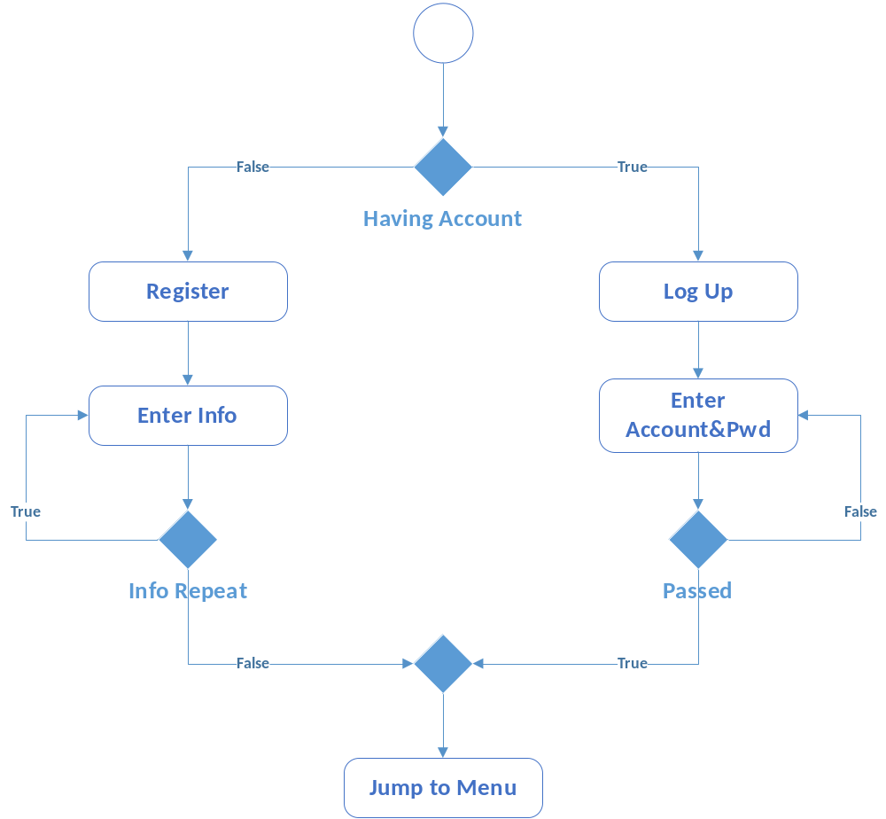
Analysis(Process Analysis)
Process Analysis
According to the requirements analysis and use case description, the process of the system is planned, so that the operating process of the system is displayed clearly.
Figure3 Log up & Register Process

Slide 12
Design
The overall system architecture is explained, and the class diagram design and interaction diagram design are completed. This chapter also includes the database design in the form of ER models and database tables.

Slide 13
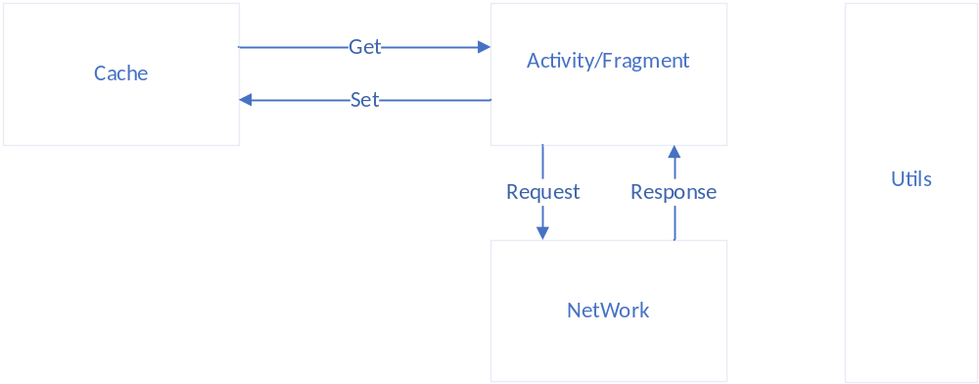
Design(Architecture design)
The front-end page is mainly XML, and the core exists in the form of Activity class, and directly controls the View layer. The remaining modules exist in the form of tools.
Figure4 Model of Android MVC

Slide 14
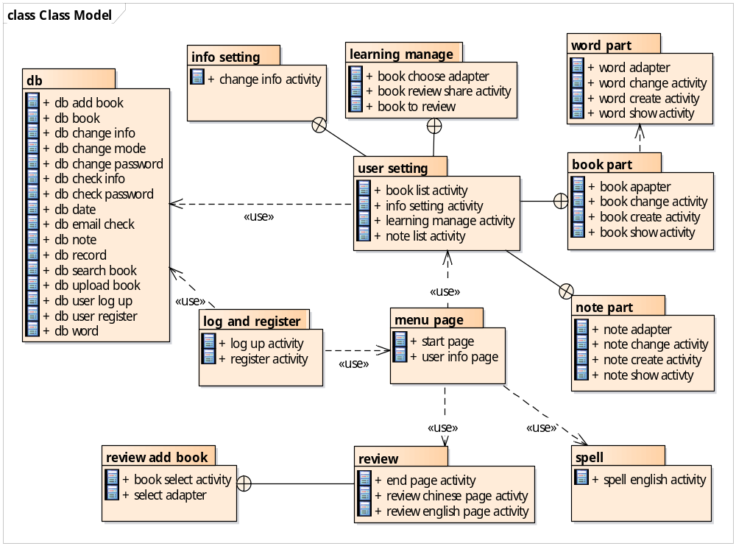
Design(Package design)
Package Name | Introduction
Db | Database tools
Menu page | Menu package
User setting | User information setting package
Review | Memorization mode package
Spell | Spelling mode package
Figure5 Package Diagram

Slide 15
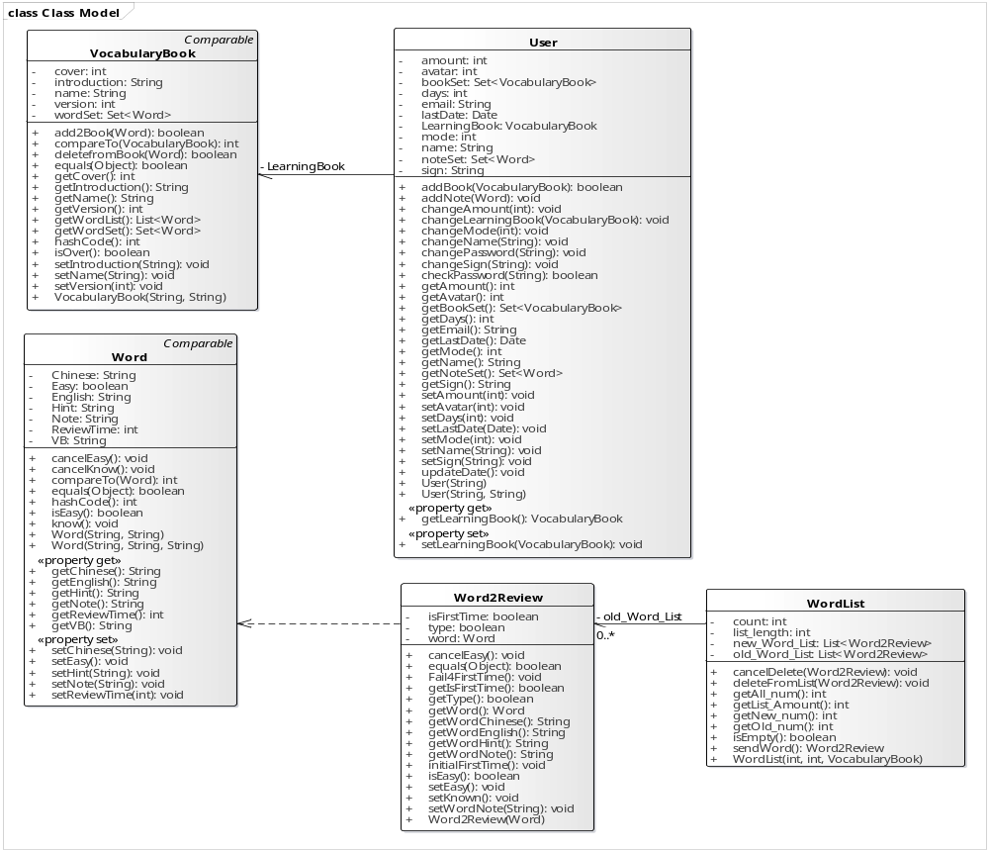
Design(Class design)
Class Name | Introduction
Vocabulary_Book | Vocabulary database
Word | Single word
Word2Review | Packaging class for recitation
WordList | List class for recitation
User | User information
Figure6 Logical Class Diagram

Slide 16
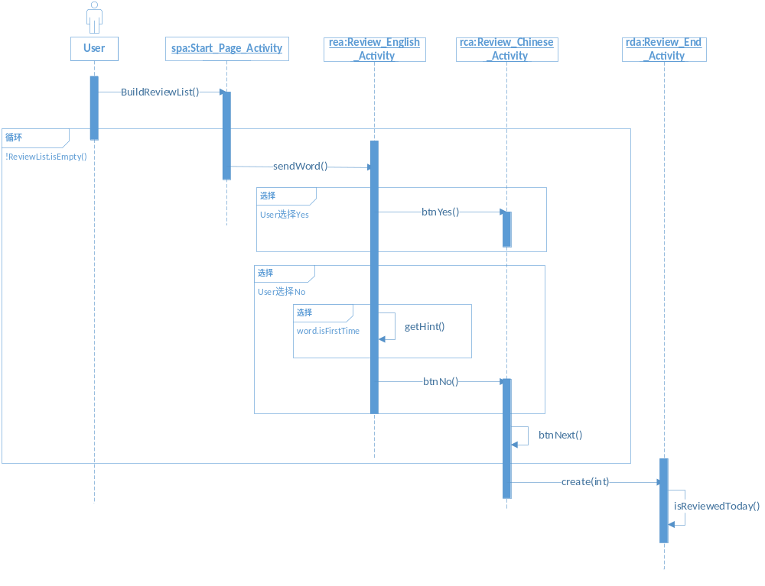
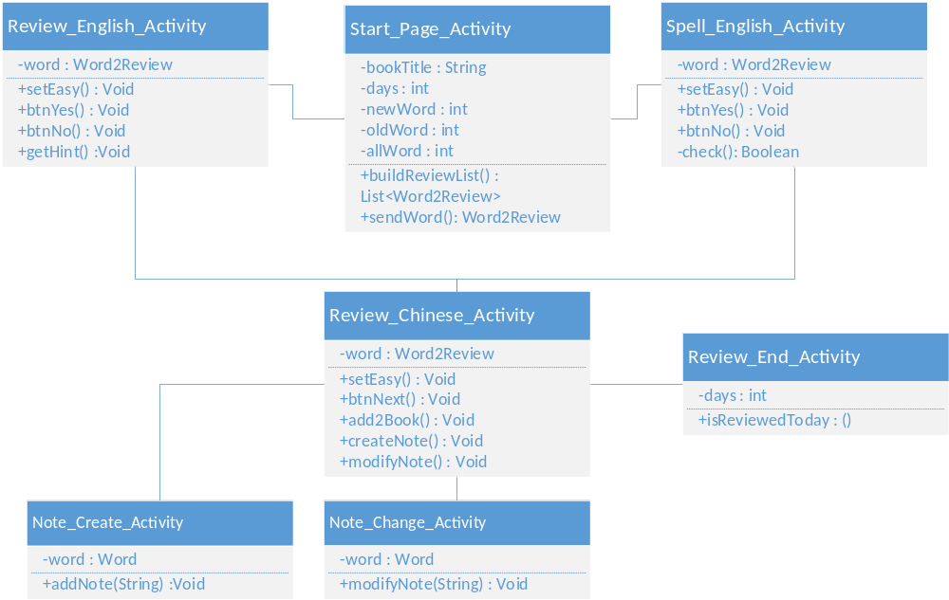
Design(Activity design)
Figure6 Activity Class Diagram(Part)
Figure7 Activity Interactive Diagram

Slide 17
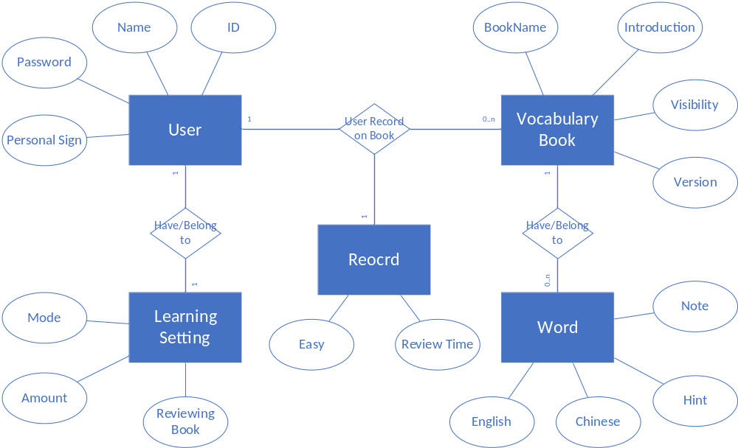
Design(Database design)
Brief Introduction
User_List
Record user account and password
User_Info
Record basic user information
User_Learning_Setting
Record user learning settings
Book_List
Vocabulary database list
Note_ID
User’s (who named ID) notes list
Book
Vocabulary database named Book
Book_ID
User’s (who named ID) recitation record of vocabulary database named Book
Figure8 ER Diagram

Slide 18
Implement
Show the implementation effect in the form of video of the actual system to illustrate the actual operation of the system.

Slide 19
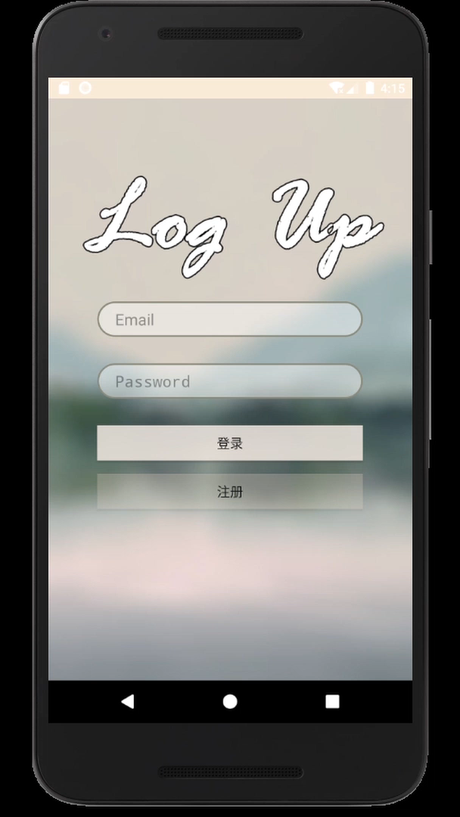

Implementation
Register and Log up
When entering the app, the login interface is first displayed. In the login interface, you can click the register button to jump to the registration interface for registration.
Application
Both in memorization mode and spelling mode, you can recite the words of chosen vocabulary database, get note tips, make notes, add word to your own vocabulary database
Management
The user information interface will display the user name and personalized signature, and there are 4 button entries.

Slide 20
Test
According to the test design and use cases, unit test and function test of the system are carried out, and the test results are shown.

Slide 21
Test
Test Design
The test process of this system mainly includes unit test and function test. The following is the test emphasis
Input content | Normal input （Minimum value <input value <maximum value)
 | Abnormal input (maximum value <input value || input value <minimum value)
 | Marginal input (Input value = minimum value || input value = maximum value)
 | Non input
Data display | Text
 | Graph
 | Table
 | Button
 | Interface not deformed
Operating point | Jump to the interface correctly
 | Android native return key has the same function as self-built return key

Slide 22
Test(Problems & Solutions)
01
02
03
[Unit Test]
Database coding problem, modified to UTF to solve
[Unit Test]
Beyond the display range, limit the input length to solve
[Functional Test]
Split prompt problem, split check function to solve
04
05
06
[Functional Test]
Empty password problem, split check function to solve
[Functional Test]
Set easy error, add take out action to solve
[Functional Test]
Jump problem,
add reset action to solve the problem

Slide 23


Test(Conclusion)
Conclusion
The system basically meets the design requirements, with complete functions and good interface. It can jump correctly according to the operation. The problems found in the test have also been solved. In general, the expected functions are realized, the application requirements are met, and the software passes the test.

Slide 24
Results & Discussion
This paper summarizes the research content of this paper, and puts forward the unsolved problems and possible improvement schemes for the existing research.

Slide 25
Results & Discussion
1
3
2
Data volume: the current test situation is local database, and the overall data volume is low. It is suggested that cloud database or big data storage should be considered to replace the existing storage form.
Extensibility design: for the functions or modules that may be added in the future, the overall interface is not sorted out in the current design, which may cause some problems for the modification and addition of modules.
Management authority: as a practical software, there should be a fixed manager to manage the data and user information. In practice, it is suggested to add background permissions to manage the overall data

Slide 26
ECNU
Thanks for listening

